Slide 1
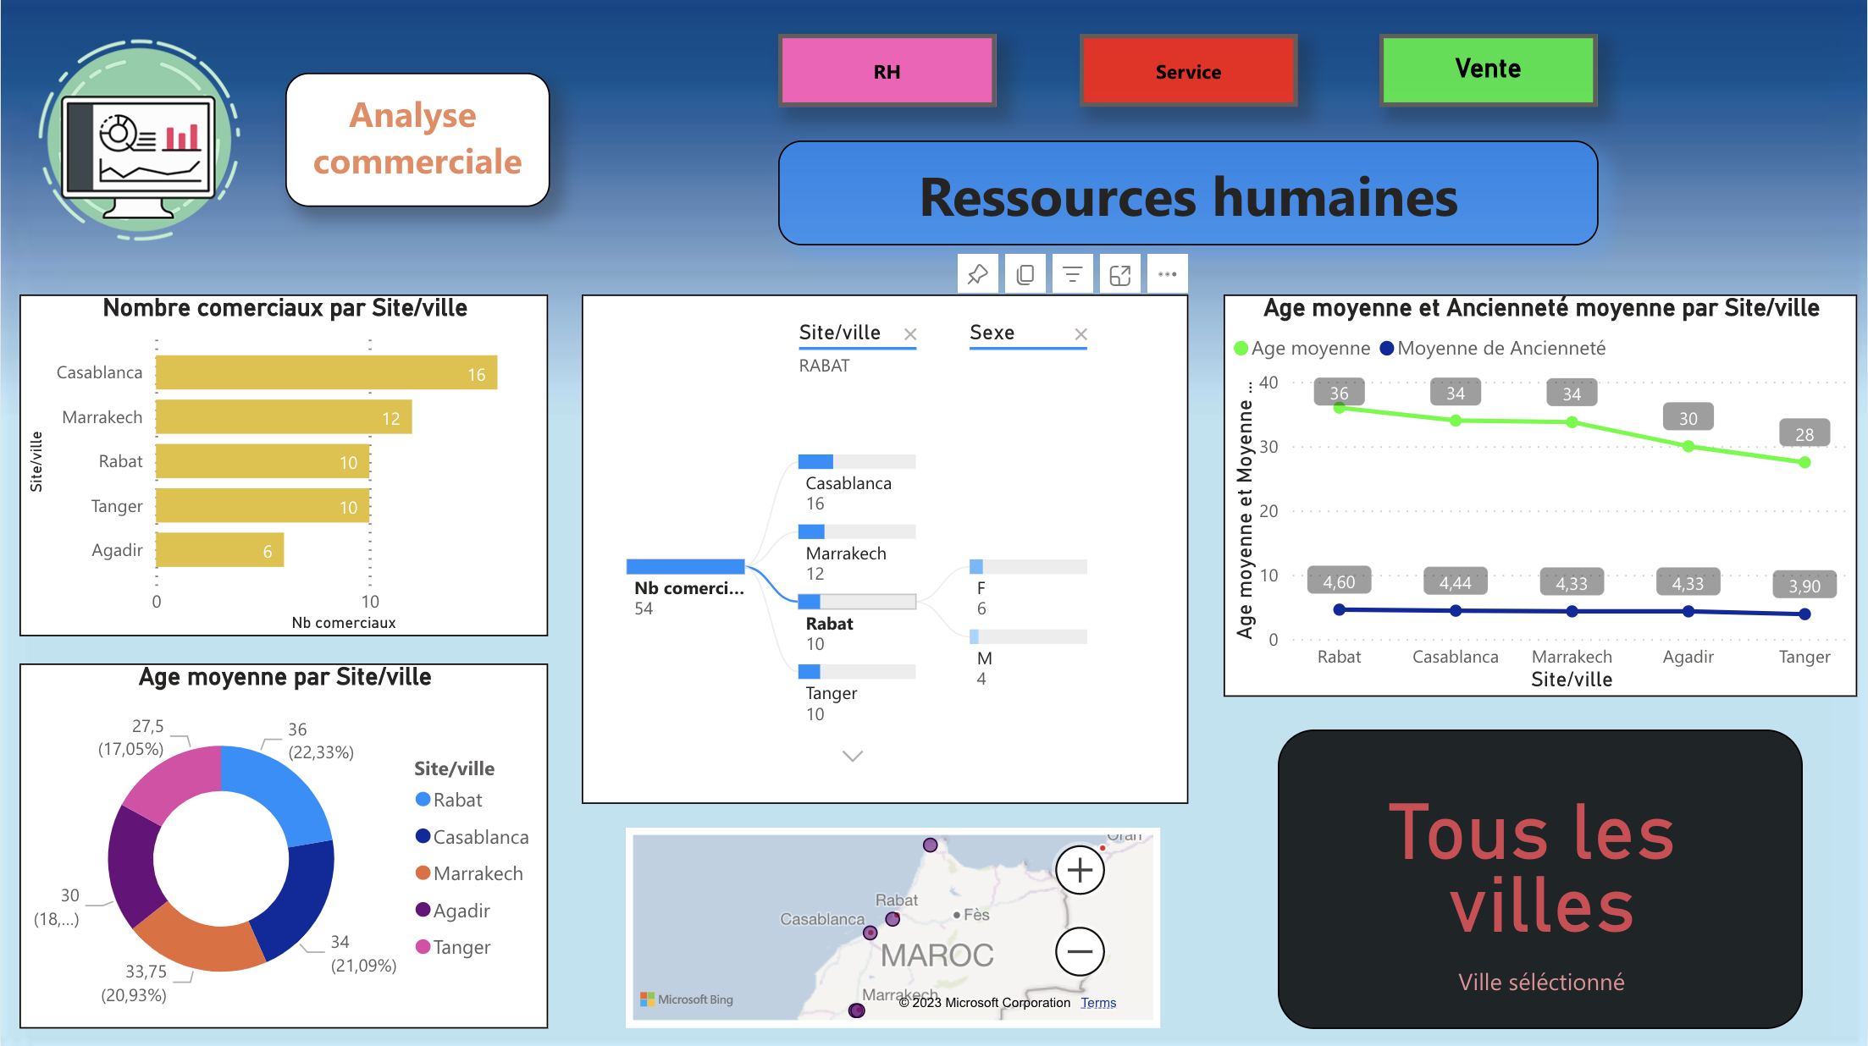

Slide 2
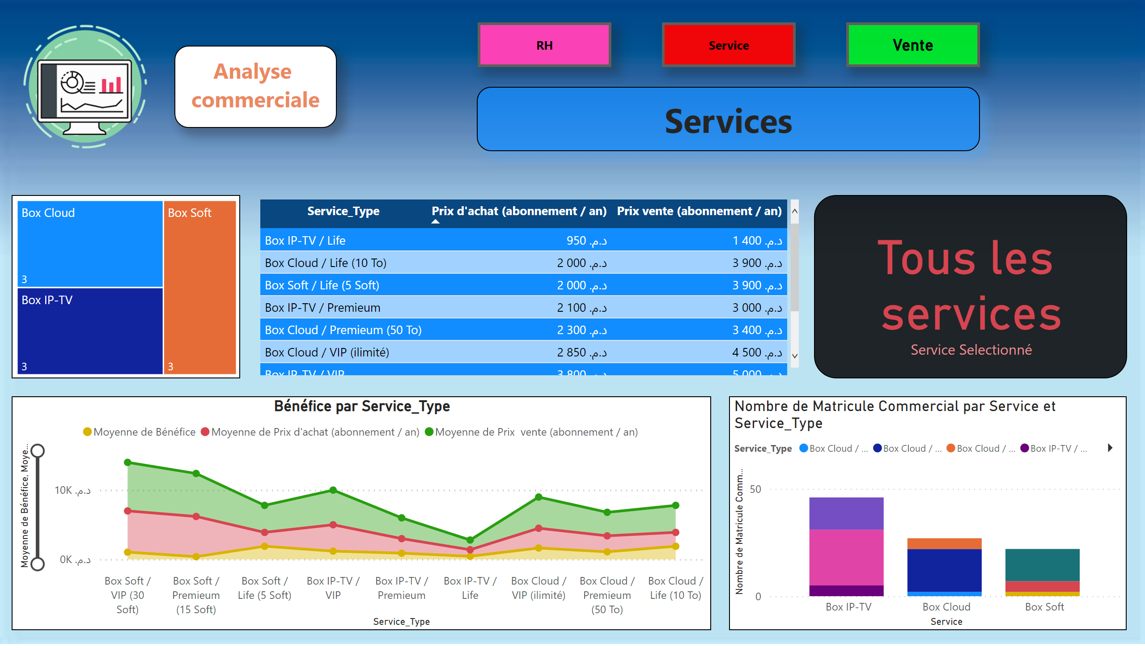
Service
Notes:
image
No alt text provided
textbox
No alt text provided
textbox
No alt text provided
treemap
No alt text provided
tableEx
No alt text provided
Bénéfice par Service_Type
No alt text provided
lineStackedColumnComboChart
No alt text provided
card
No alt text provided
RH
No alt text provided
actionButton
No alt text provided
actionButton
No alt text provided

Slide 3
